Slide 1
Raycasting in GLSL
(Step-by-step exercises)
Advanced Graphics Programming

Slide 2

Exercise 1 (ray direction)

Slide 3

Exercise 2 (Sky gradient - ray Y component)

Slide 4

Exercise 3 (floor plane intersection)

Slide 5

Exercise 4 (sphere intersection)

Slide 6
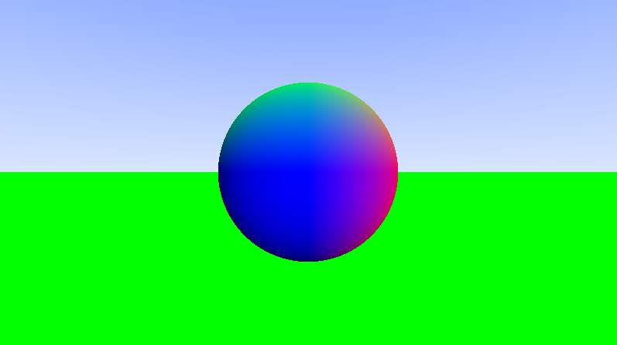
Exercise 5 (surface normals)

Slide 7
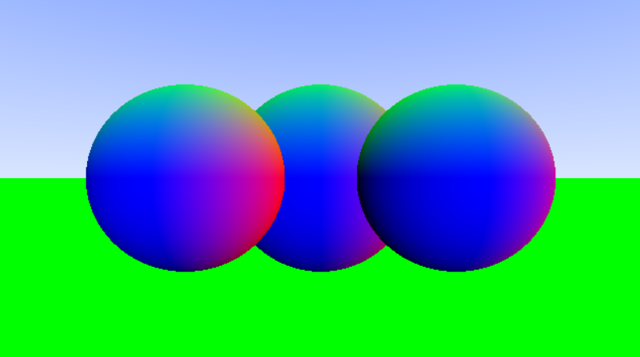
Exercise 6 (arrays)

Slide 8
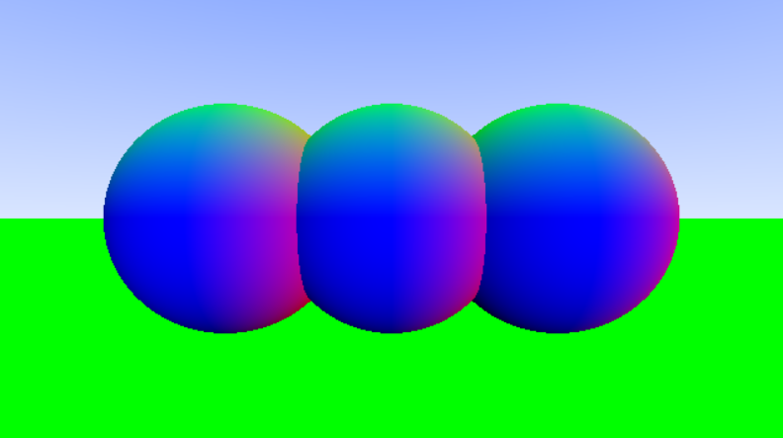
Exercise 7 (nearest intersection)

Slide 9
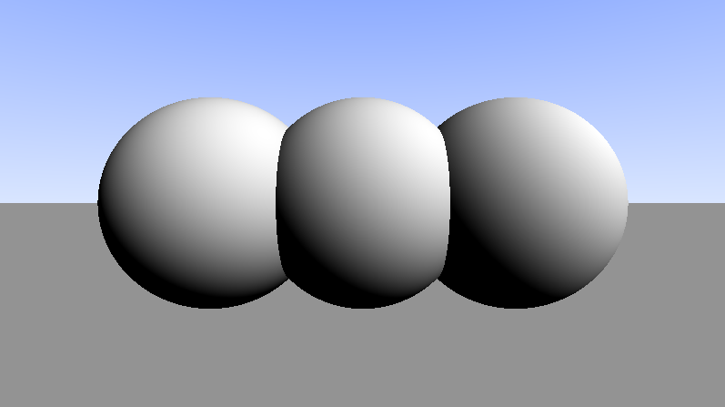
Exercise 8 (shading)

Slide 10
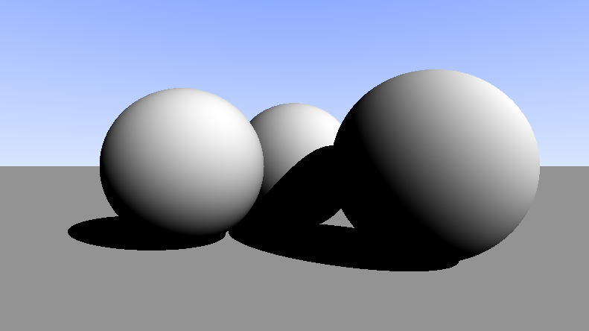
Exercise 9 (hard shadows)

Slide 11
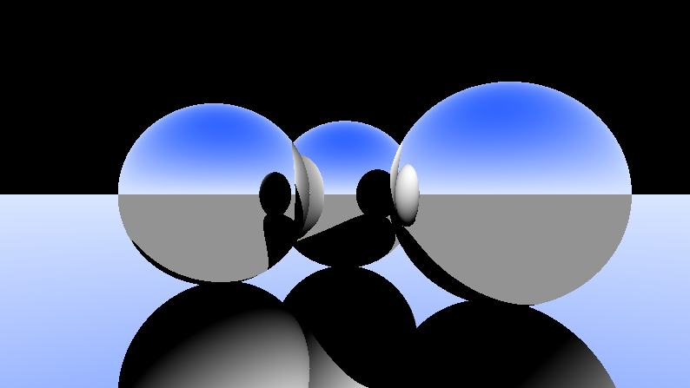
Exercise 9 ½ (1-bounce reflection)

Slide 12
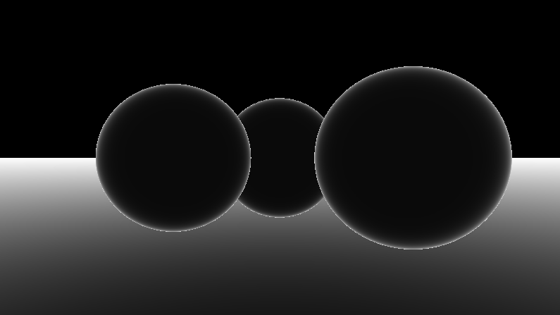
Exercise 10 (fresnel term)

Slide 13
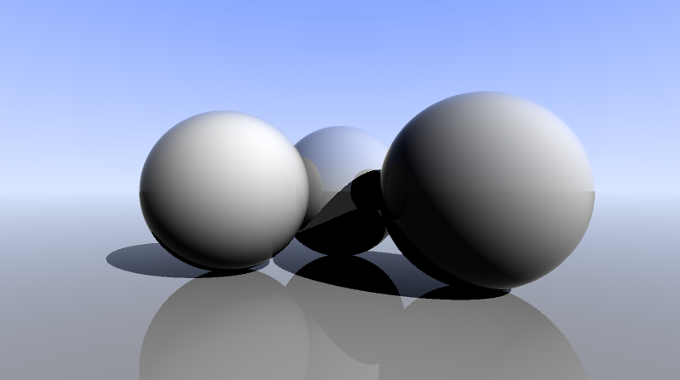
Exercise 11 (1-bounce reflections)
direct
reflection
fresnel
mix(direct, reflection, fresnel)

Slide 14
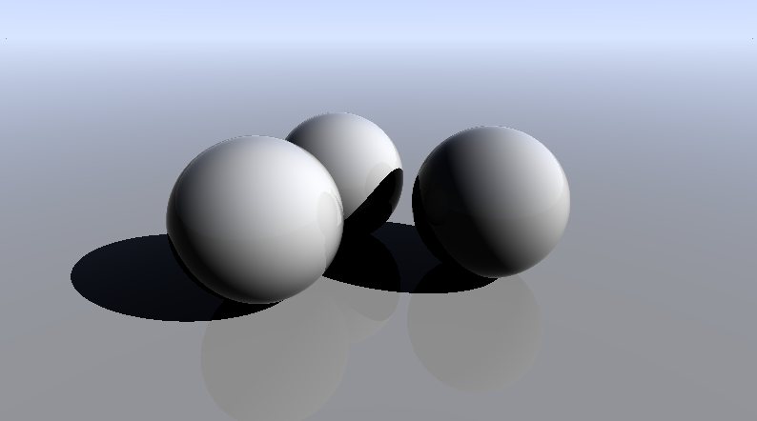
Exercise 12 (camera position)

Slide 15
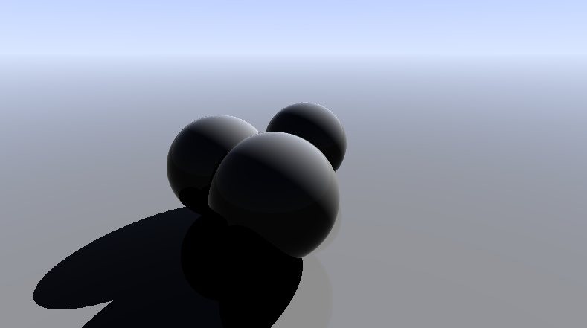
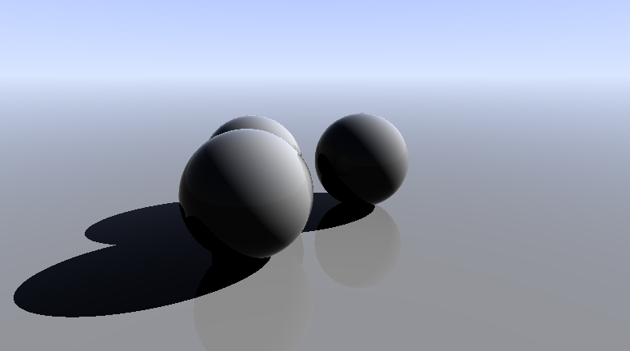
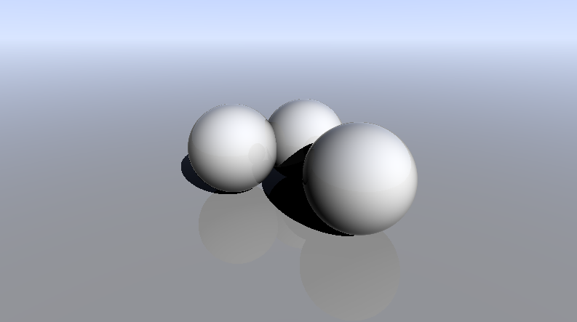
Exercise 13 (mouse interaction)

Slide 16
Exercise 14 (anti-aliasing)

Slide 17
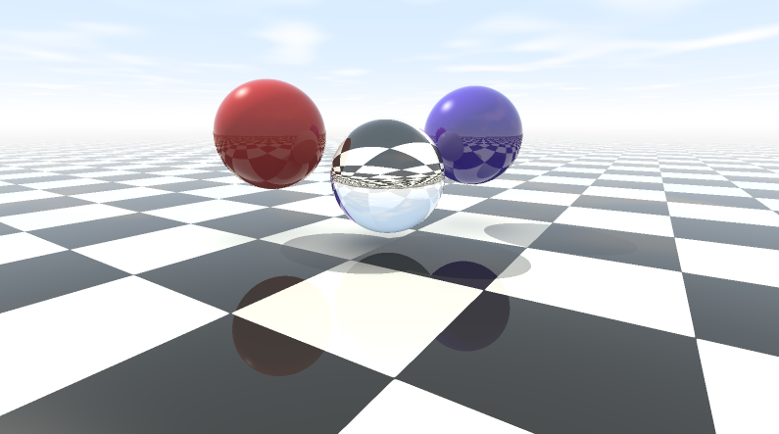
Go for it!!!

